Slide 1
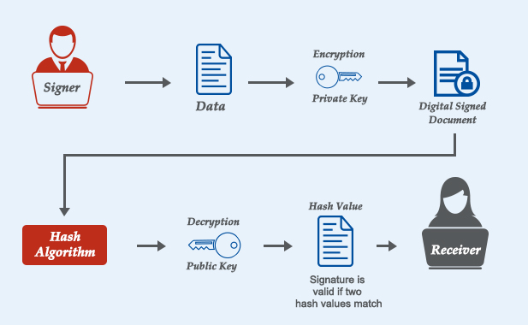
BCSE309L - Cryptography and Network Security
Module 5 - ElGamal based Digital Signature

Slide 2
Contents
CO3 : To apprehend the authentication and integrity process of data for various applications
Authentication Requirements, Authentication Functions, Message Authentication Codes
Digital Signature Authentication, Authentication Protocols
Digital Signature Standards (DSS)
RSA Digital Signature, Elgamal based Digital Signature
Authentication Applications: Kerberos
X.509 Authentication Service
Public Key Infrastructure (PKI)

Slide 3
Digital Signatures Schemes
ElGamal Digital Signature Scheme - “Taher AlGamal (1985)”
Schnorr Digital Signature Scheme - “Claus Peter Schnorr (1991-2008)”
Digital Signature Standard (DSS)

Slide 4
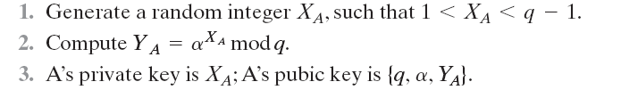
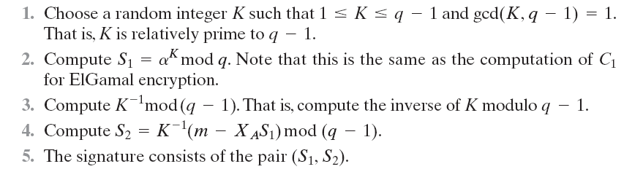
Digital Signatures ElGamal Scheme
Let q is prime number & α is a primitive root of q
Generate the private/ public keys
Sign the message

Slide 5

Digital Signatures ElGamal Scheme
Verify the message
If V1=V2
No
Not valid
Yes
Valid

Slide 6
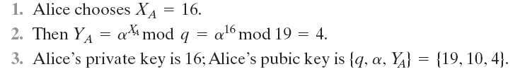

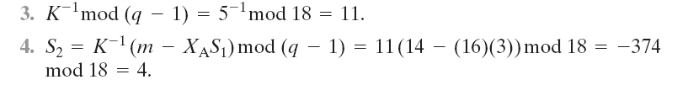
Digital Signatures ElGamal Scheme - Example
Let q=19;
Primitive roots of q= {2, 3, 10, 13, 14, 15};
α=10
Generate the private/public keys
Alice wants to sign a message
Let m = 14

Slide 7
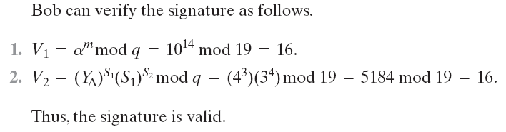
Digital Signatures ElGamal Scheme – Example (cont…)
Verify the message

Slide 8
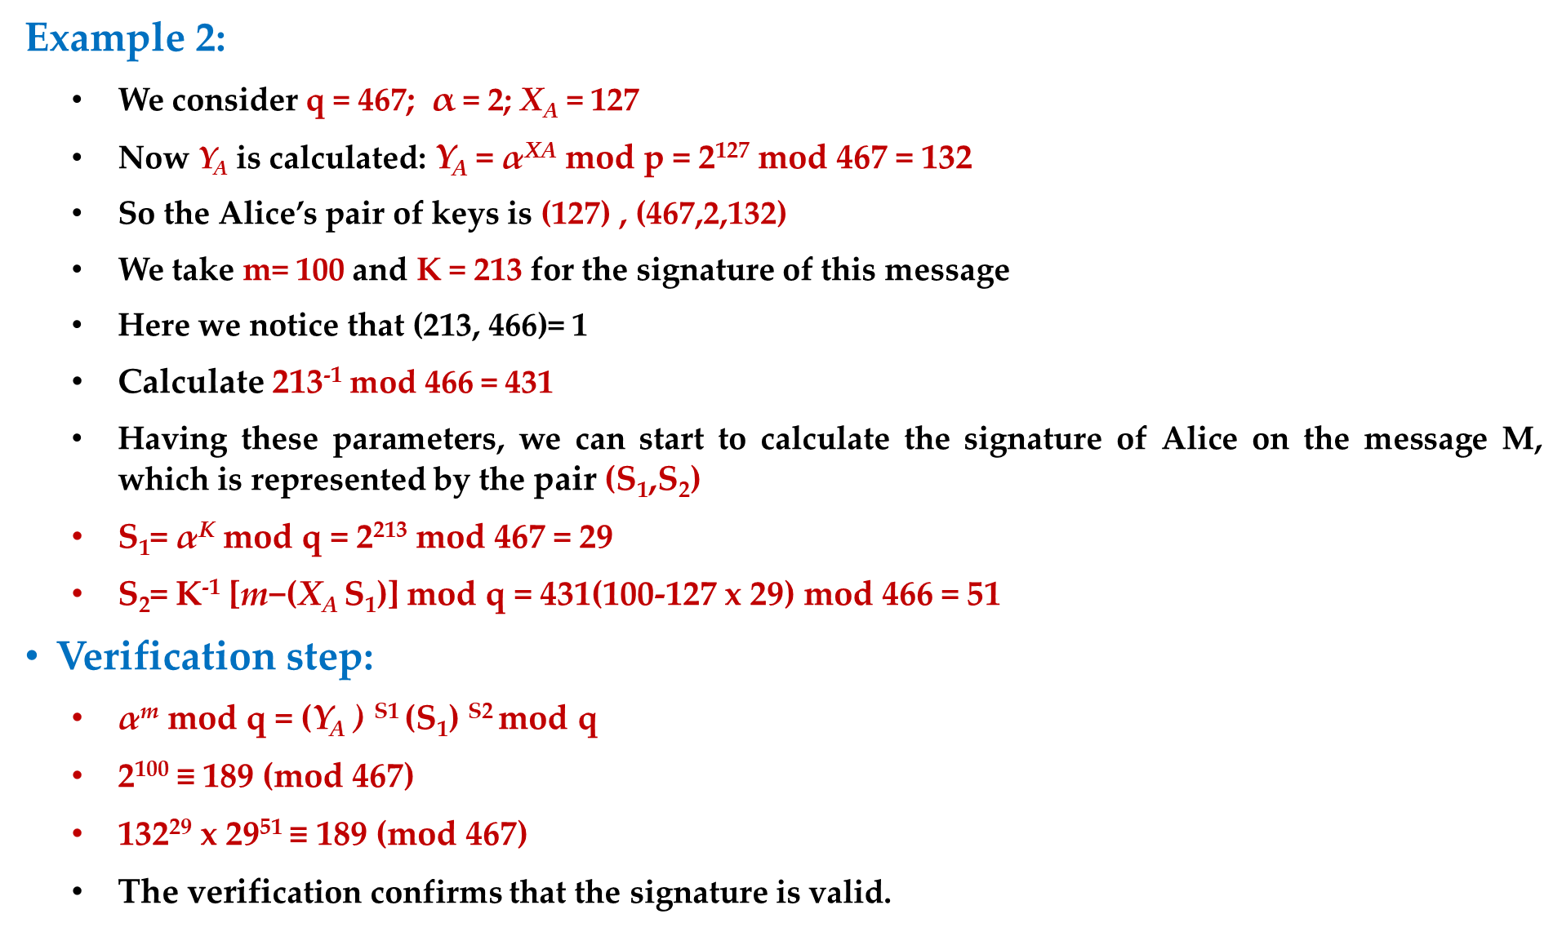
Digital Signatures ElGamal Scheme

Slide 9
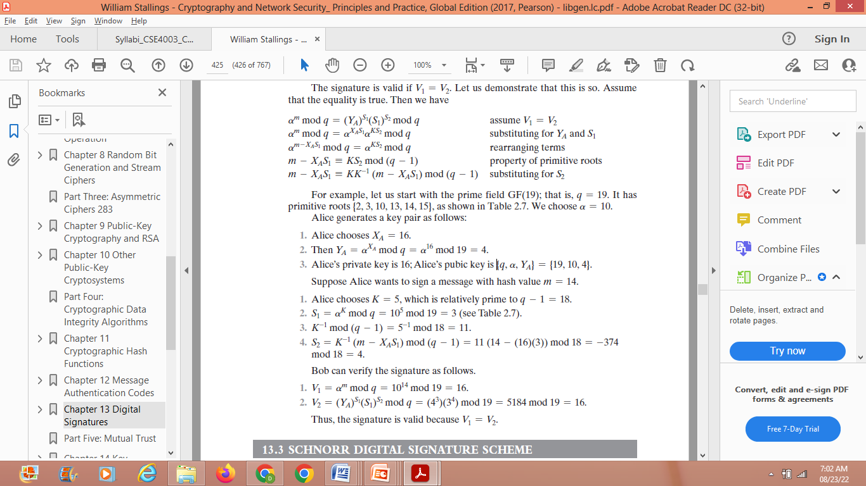
Example

